Slide 1
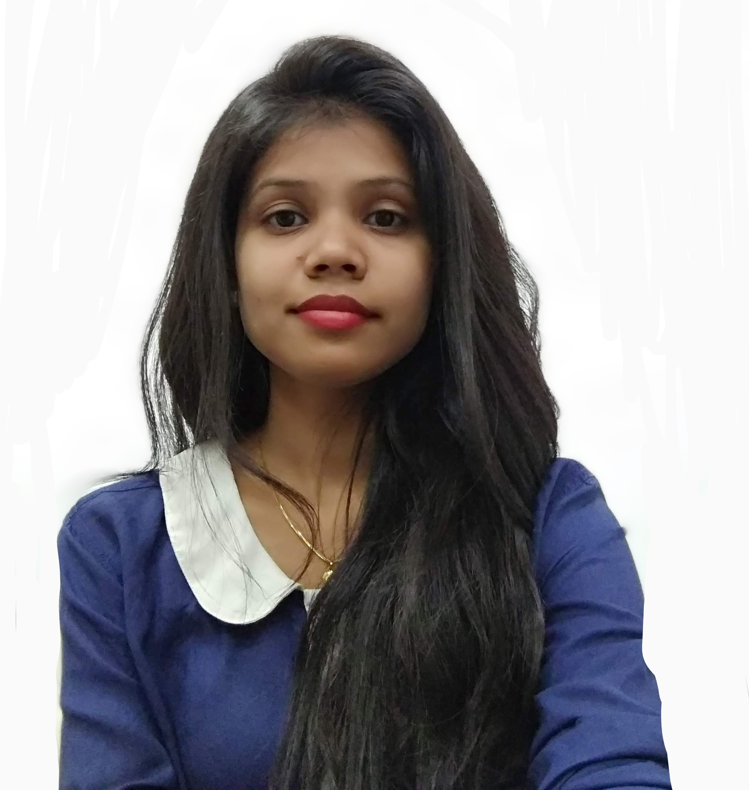

Nikita Deepak Poyrekar Consultant, Deloitte India
Professional Experience
Nikita is a Front-end developer with Deloitte India. She has close to 3 years of experience in software development and client management roles. She has developed enterprise applications with visually responsive elements using state-of-the-art JS frameworks like Angular, React JS and Next.js. She has led the entire PED (Product, Engineering and Design) team for projects across Healthcare, Property and retail management sectors.
Key competencies and experience include -
Experienced in Waterfall & Agile Software development practices
Experienced in presenting product demonstrations and project delivery updates
Tools & Technology:
Programming languages: JavaScript, TypeScript, HTML5, CSS3, Less, Python, etc.
Frameworks: Angular, Next.js, Bootstrap, Semantic UI, Materialize and Tailwind CSS
Libraries: React, Redux, Angular Material and Ant design
Version control: Git, GitHub and Bitbucket
UI design tools: Figma, InVision and Zeplin
API collaboration: POSTMAN and Swagger
Project management tools: Rally, Airtable and Atlassian tools like JIRA and Confluence
Test libraries/frameworks: JEST, React testing library and Cypress.
Task runners: Gulp4
CI/CD: Working knowledge of Jenkins
Cloud Fundamentals: Google Cloud Platform (GCP), CMS: Strapi
npoyrekar@deloitte.com
Phone: +91 897 654 8557
Qualifications
MTech: Autonomous (KJSCE Mumbai)
B. E: Mumbai University
Certifications
Google Certified Cloud Digital Leader
Key Engagements
Other Technical certifications – Click here
Developing an application that facilitates applying credit to finance a vehicle purchase for Europe's leading automobile E-commerce platform. The range of responsibilities undertaken during the tenure includes - backlog management, process definition, development, QA, and delivery management.
Designed and built a digital platform to simplify tenant and landlord management functions for the leading USA-based Commercial Real Estate organization. The role involved gathering requirements, identifying resolutions to the existing problems/challenges, developing technical specifications and executing the same. Also developed an internal tool which reduced the TTM for a website from 6 weeks to 1.
Developed a secure online platform for an Indian Pharma client. The scope of responsibilities undertaken included – understanding/analyzing the requirements, defining priorities, development, quality analysis, product demonstrations and deployment.
Primary skills
Front-end development – React Js, Angular and Next.js

